Slide 1
What can data science do for your city?
Rayid Ghani

Slide 2
What can data science do for your city?
Data science/machine learning/AI
Rayid Ghani

Slide 3
What can data science do for your city?
Data science/machine learning/AI
help with
Rayid Ghani

Slide 4
What can data science do for your city?
Data science/machine learning/AI
help with improving outcomes for people in
Rayid Ghani

Slide 5
What can data science do for your city?
Data science/ machine learning/ AI
help with improving the equity in outcomes for people in
Rayid Ghani

Slide 6
What can DS/ML/AI help with to improve the equity in outcomes for people in your community?
Rayid Ghani

Slide 7
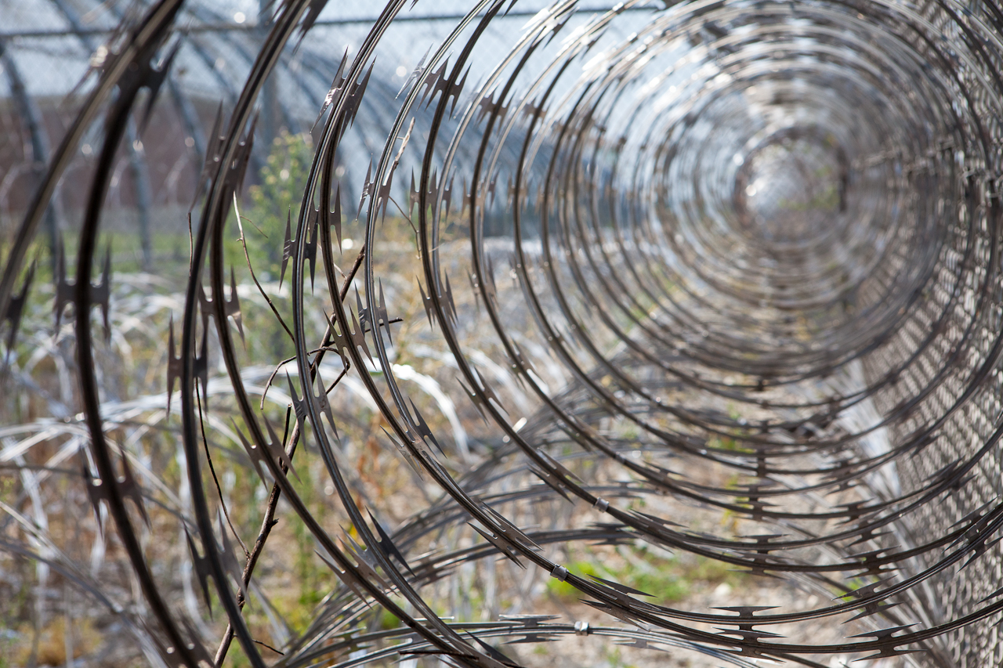
Reducing jail recidivism with proactive mental health interventions (Johnson County, KS)
15:40
11 MILLION
people move through 3,100 Jails
22 BILLION
in cost
64%
suffer from mental illness
68%
have a substance abuse disorder
44%
suffer from chronic health problems

Slide 8
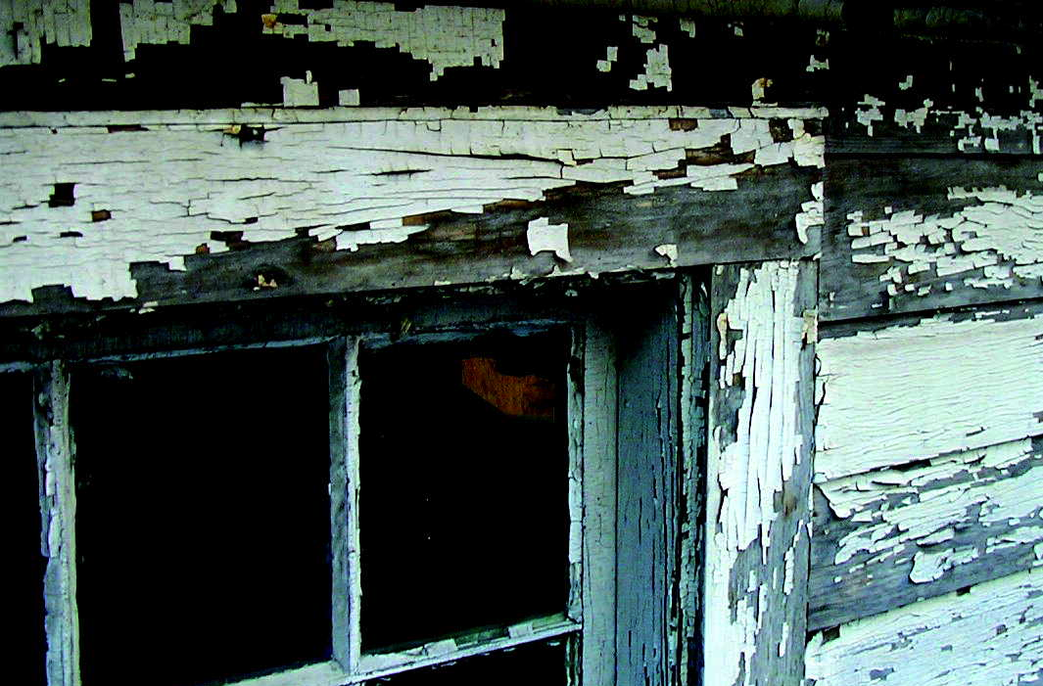
Preventing Lead Poisoning in Children (Chicago, IL)
LEAD
Children in at least 4MM US households are exposed to high levels of lead
Impaired Attention
Lack of Motor Skills
Hearing Loss
Learning Disability
Lower IQ
Memory Problems

Slide 9
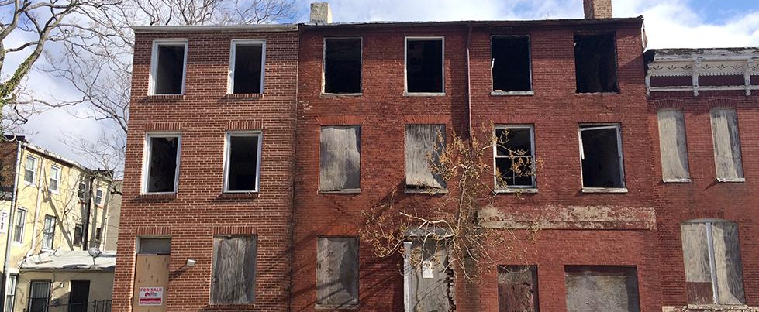
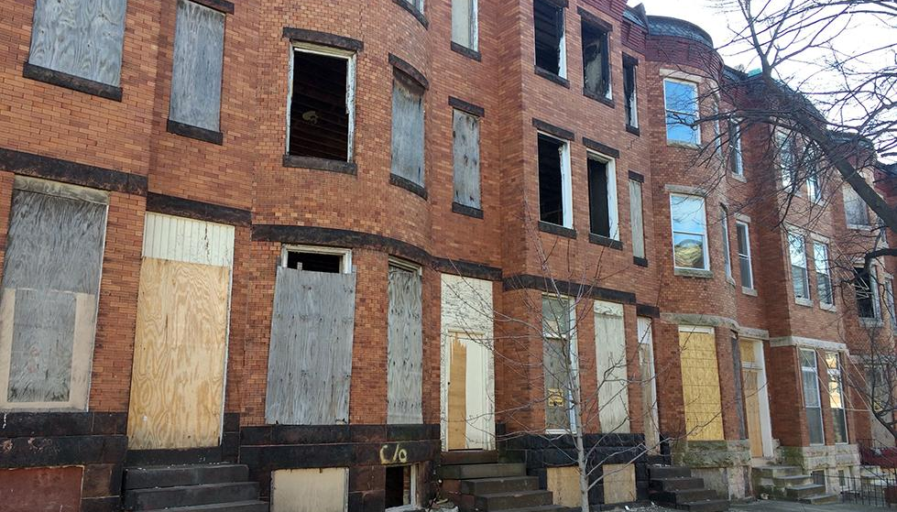
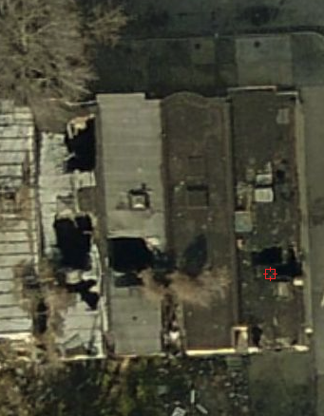
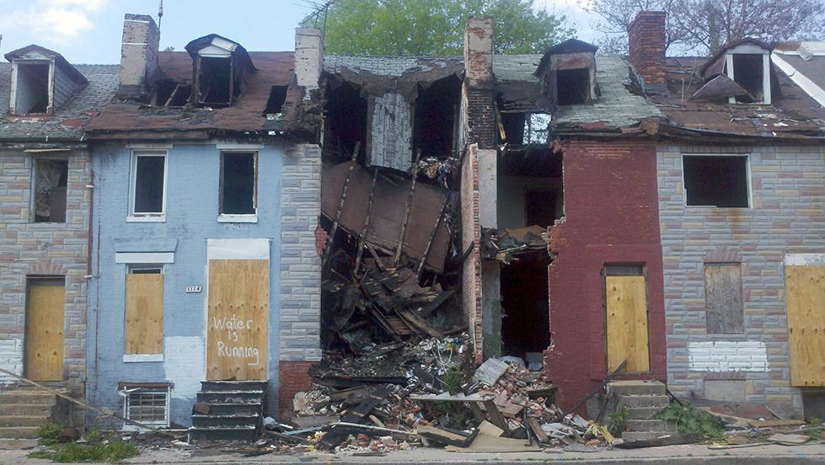
Identifying Buildings with Roof Damage for Demolition or Stabilization Inspections
Notes:
Roof damage is important to detect and address because it lets it rain and other elements and causes structural damage to the home and homes around it. It’s a widespread problem with high human impact for the city.

Slide 11
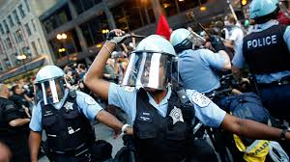
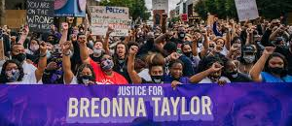
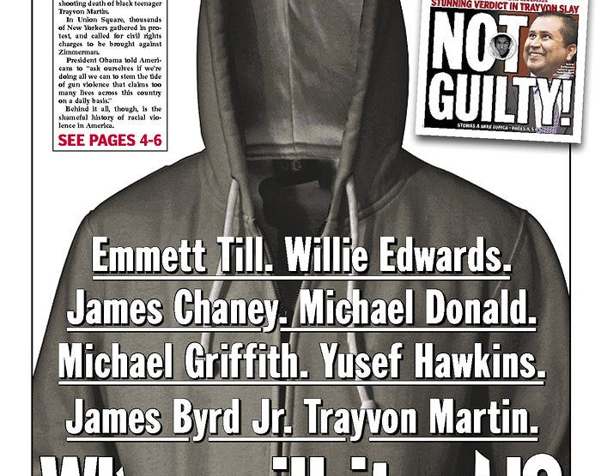
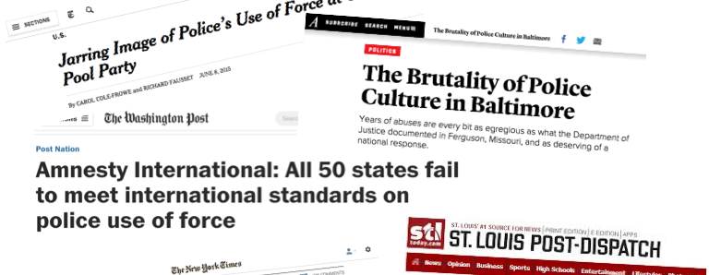
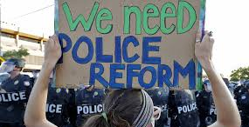
Reducing Adverse Police Incidents (Charlotte Mecklenburg, NC and Nashville, TN)

Slide 12
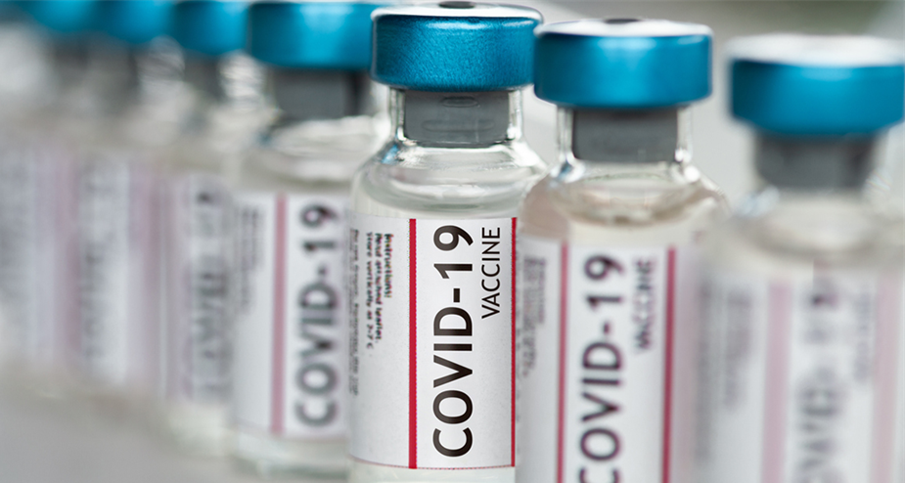
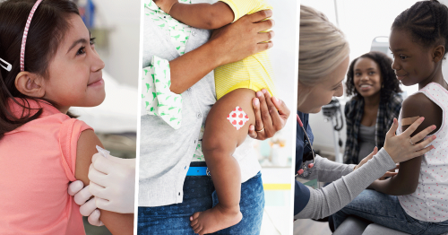
Increasing vaccination rates in children (Mexico)

Slide 13
Increasing Educational Outcomes for Students – work in the US and El Salvador
20%
Of High School
Students in the US
DROP OUT
EVERY YEAR, 1.3 MILLION STUDENTS DROP OUT OF SCHOOL
1
7,000
EVERY DAY
OF SCHOOL
OR
EVERY 26
SECONDS

Slide 14
Increasing Retention in Care for HIV+ Patients

Slide 15
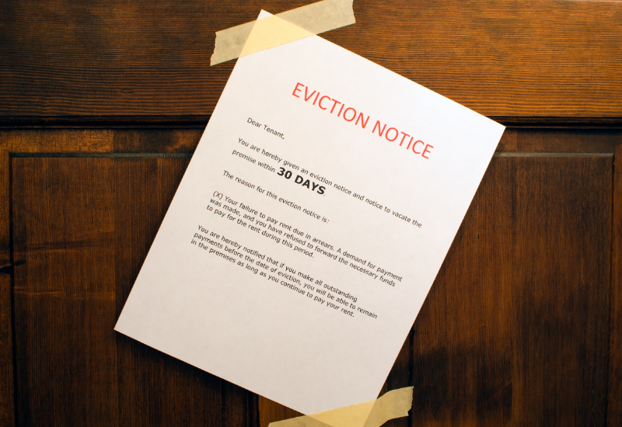
12:00pm

Slide 16
Improving Inspection Programs
Increasing workplace Safety (Chile)
Reducing Health and Safety Issues in Rental Housing
Early Detection of Blight
Increasing compliance with hazardous waste disposal regulations

Slide 17
Analyzing Traffic Video Footage to Reduce Fatal Traffic Accidents (Jakarta)

Slide 18
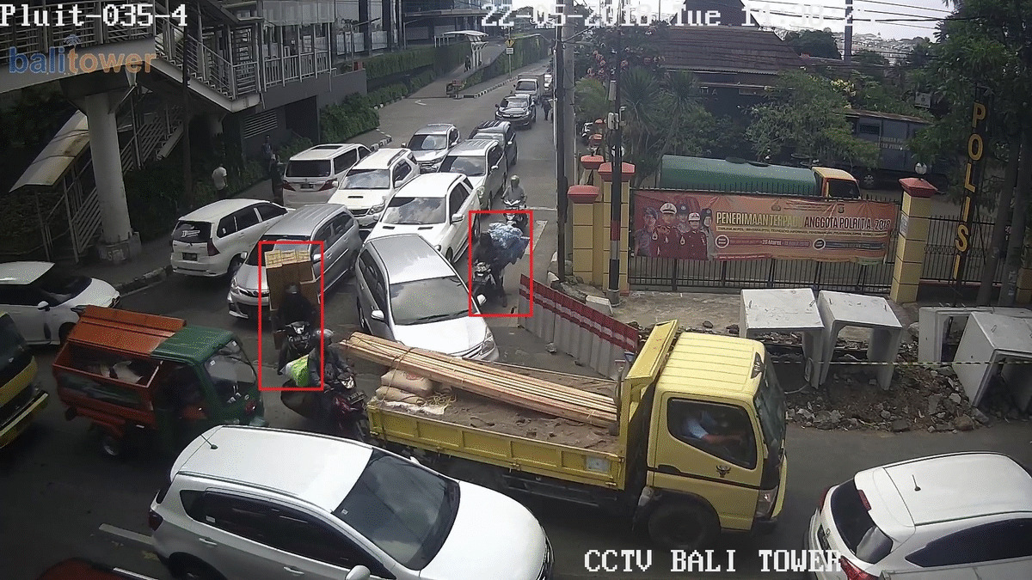
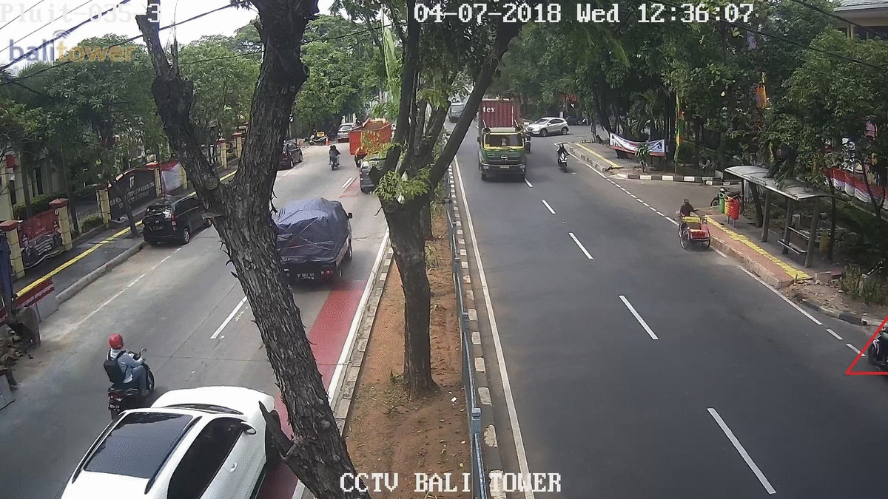
Pedestrians walking through traffic
Non-vehicles using the roadways
Vehicles driving the wrong way
Overloaded motorcycles

Slide 19
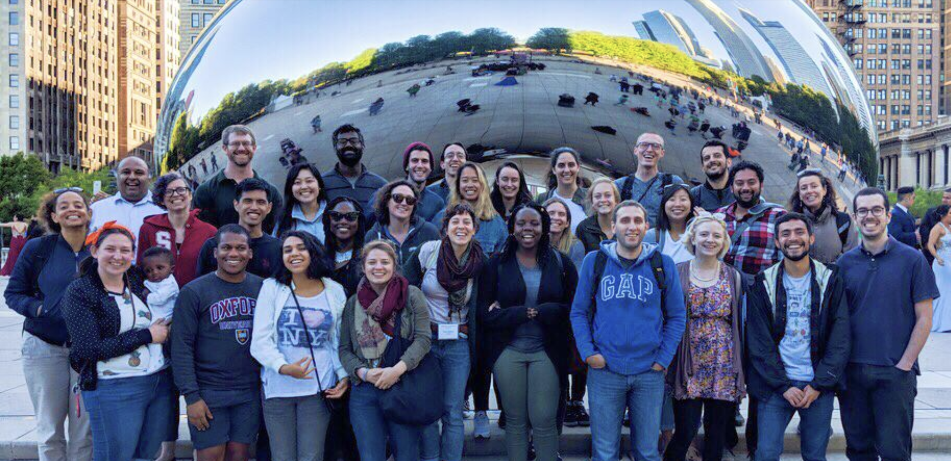
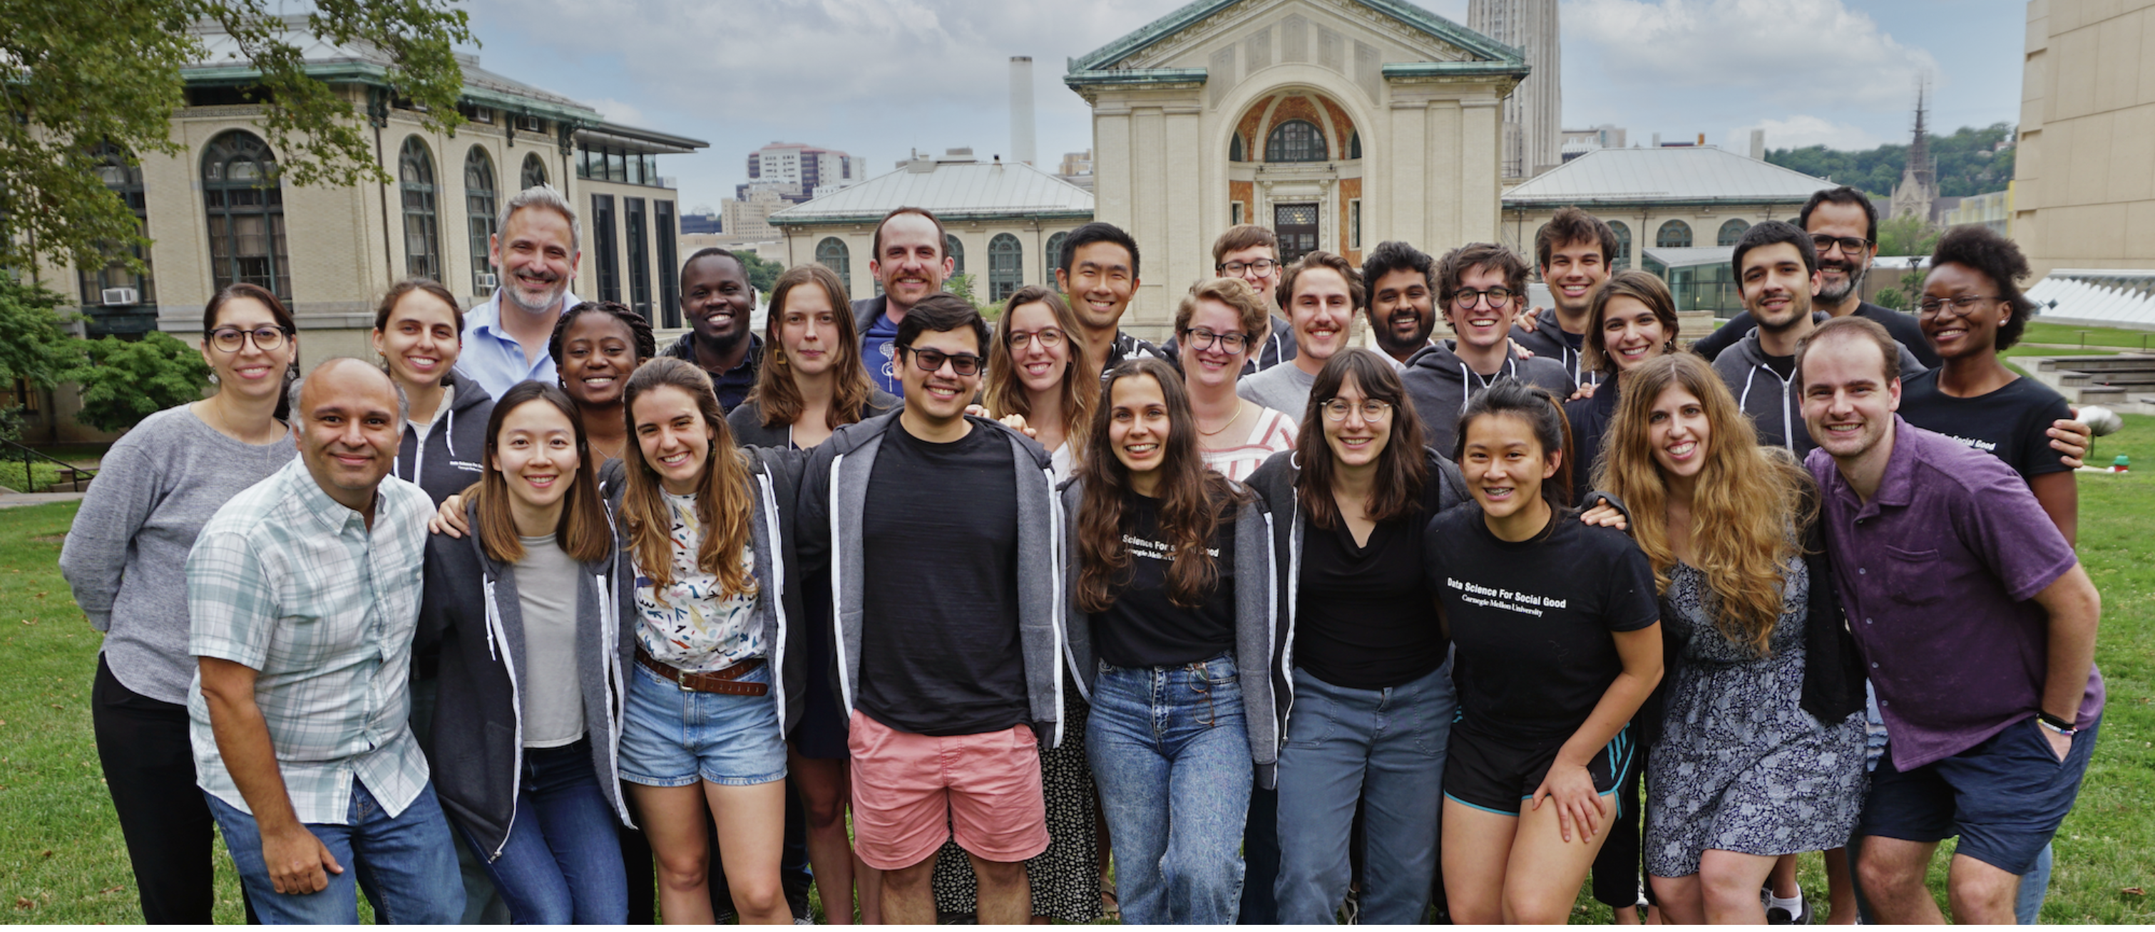
More details on projects at http://dssgfellowship.org/projects

Slide 20
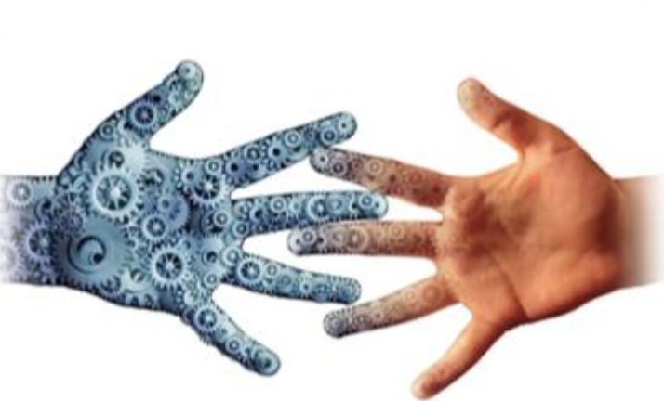
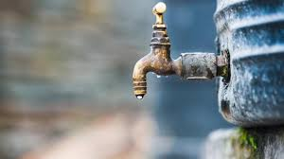
How do we develop DS/AI/ML systems that help humans make decisions that lead to fair and equitable outcomes?
Human-AI collaborative systems
Allocation of Limited Resources
Balancing goals of equity, efficiency, and effectiveness

Slide 21
AI/ML systems are heavily dependent on humans to determine a wide range of aspects of their design, development, and use

Slide 22
(Re)thinking how we design AI systems
What values should the AI system be designed to achieve?
How do we build it to achieve those values?
How do we validate and monitor that it continues to achieve those values?
Notes:
Ideally, responsible AI involves reconciling the interests of all stakeholders:
Promoting benefits and reducing harms to improve performance for everyone.
Responsible AI involves searching for win-win solutions before moving to tradeoffs.
When tradeoffs cannot be avoided, they should be justifiable to the stakeholders involved.
Ensuring that AI systems are used in ways that conform to some basic ethical values:
Promote benefit
Avoid and mitigate harm
Respect autonomy
Ensure fairness.
At an organizational level, advancing these goals requires
that stakeholders understand various aspects of AI Systems
Transparency, interpretability, explainability
A system of accountability for ensuring that these goals are met within an organization.

Slide 23
What values should we design for?
Accuracy
Profit
Efficiency

Slide 24
What values should we design for?
Fairness
Explainability
Privacy
Transparency
Inclusiveness
Accountability

Slide 25
The focus is not just on making the ML model fair but rather on making the overall system and outcomes fair
Define (desired fairness or equity goals)
Understand (root causes of bias)
Improve (fairness of AI systems)
Measure and Detect (bias)
Mitigate (the impact through adjusting interventions)
Monitor & Evaluate

Slide 26
The focus is not just on making the ML model fair but rather on making the overall system and outcomes fair
Define (desired fairness or equity goals)
Understand (root causes of bias)
Improve (fairness of AI systems)
Measure and Detect (bias)
Mitigate (the impact through adjusting interventions)
Monitor & Evaluate

Slide 27
Many Bias Measures: How do we select what we design for?
Do we allocate equal resources to every group?
Do we allocate resources proportional to need?
Do we make sure we don’t miss people with of a certain group disproportionately?
Do we make sure we don’t have disproportionate false positives from a particular group?
...

Slide 28
Many Bias Measures: How do we select what we care about?
Statistical/Demographic Parity
Impact Parity
False Discovery Rate Parity
False Omission Rate Parity
False Positive Rate Parity
False Negative Rate Parity
...

Slide 29
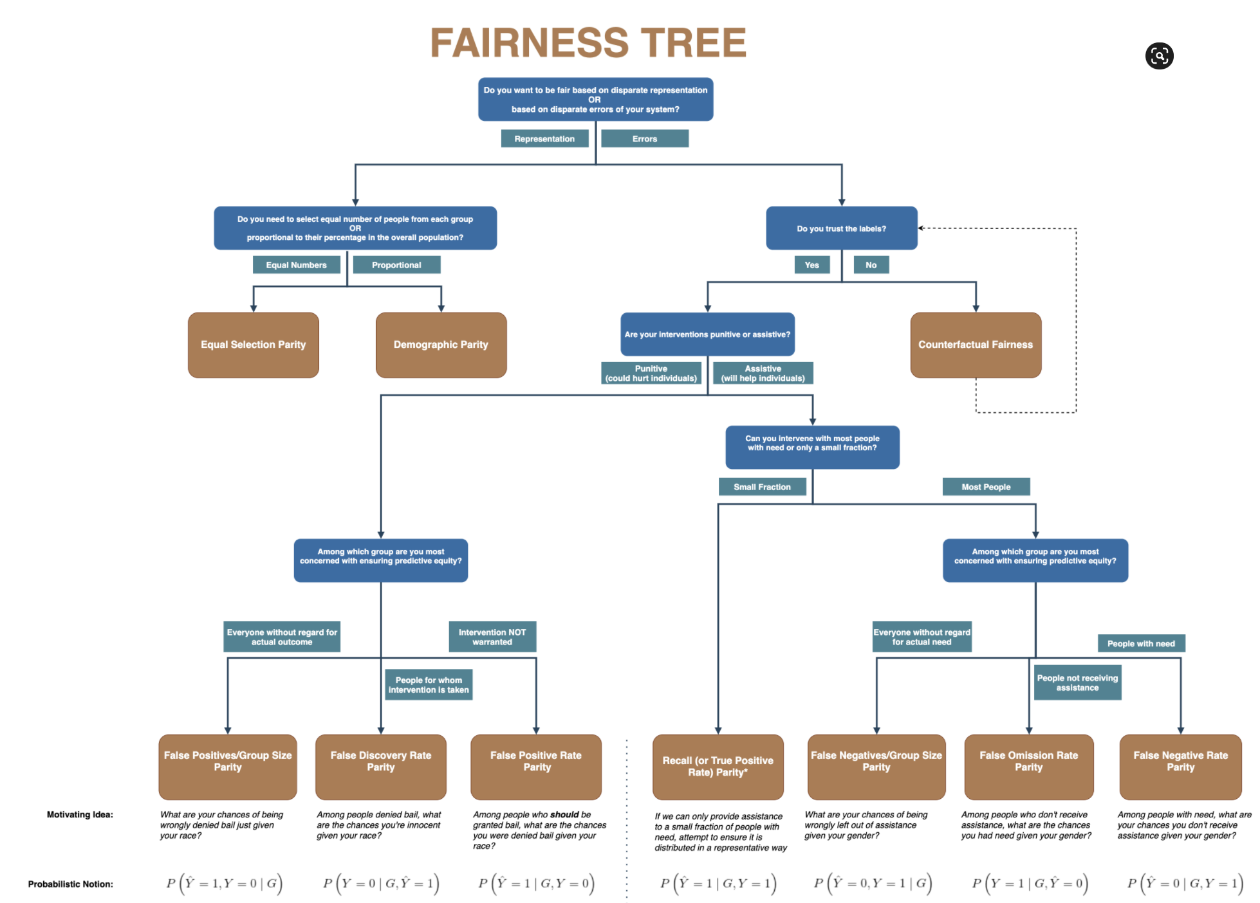

Slide 30
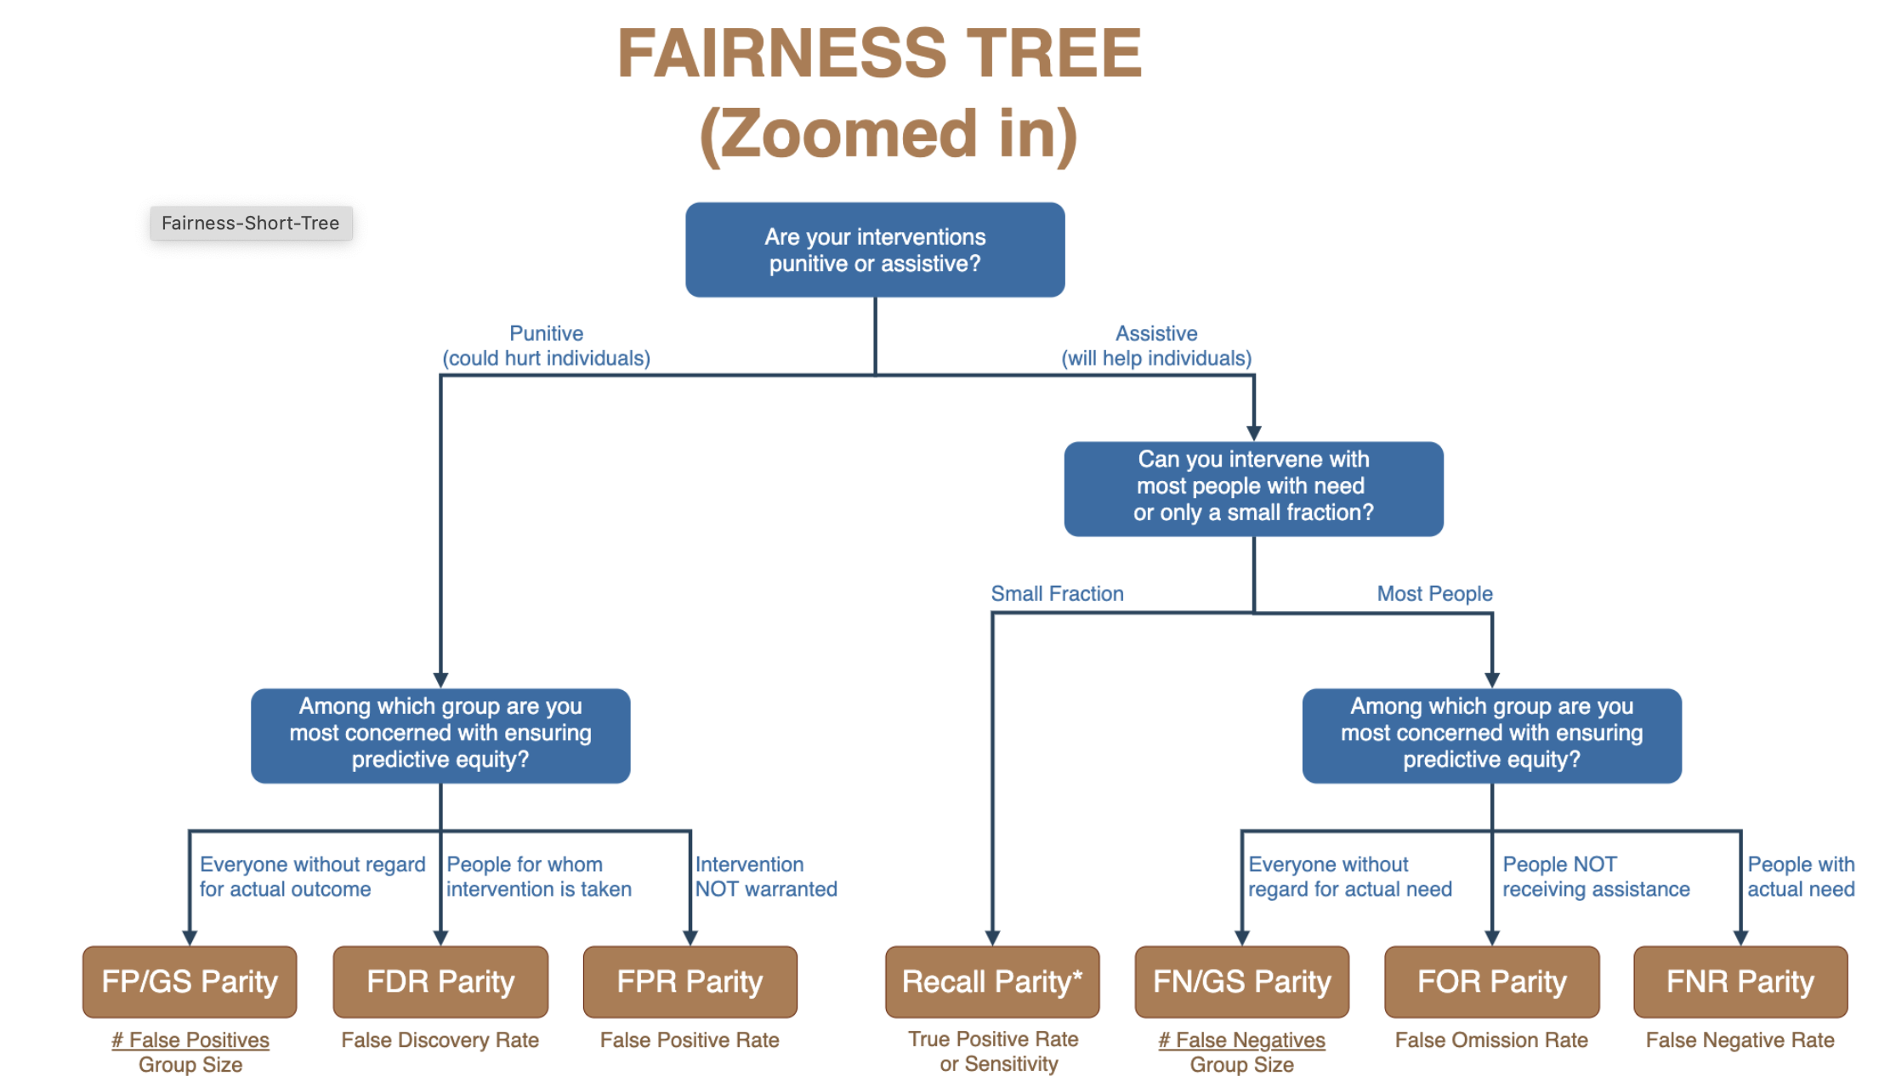

Slide 31
The focus is not just on making the ML model fair but rather on making the overall system and outcomes fair
Define (desired fairness or equity goals)
Understand (root causes of bias)
Improve (fairness of AI systems)
Measure and Detect (bias)
Mitigate (the impact through adjusting interventions)
Monitor & Evaluate

Slide 32
What is needed
Aequitas
Open Source Bias & Fairness Audit Tool
Tools
Case Studies
Regulations
Review Boards

Slide 33
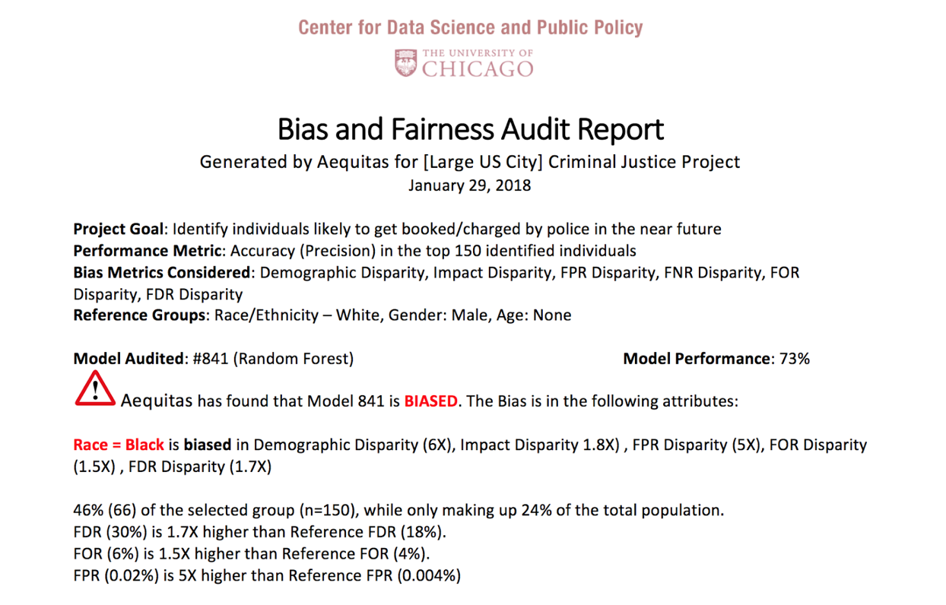
Aequitas: Bias Audit Tool
http://datasciencepublicpolicy.org/aequitas

Slide 34
The focus is not just on making the ML model fair but rather on making the overall system and outcomes fair
Define (desired fairness or equity goals)
Understand (root causes of bias)
Improve (fairness of AI systems)
Measure and Detect (bias)
Mitigate (the impact through adjusting interventions)
Monitor & Evaluate

Slide 35
Diagnosing the root causes of bias in AI/ML Systems
World
AI Pipeline
Actions
Data
Disparity in Outcomes
Bias and disparity (in outcomes) can come from any of these four components
Sample Bias
Measurement Bias
Label Bias
System Developers
Complexity or flaws
Design Choices

Slide 36
The focus is not just on making the ML model fair but rather on making the overall system and outcomes fair
Define (desired fairness or equity goals)
Understand (root causes of bias)
Improve (fairness of AI systems)
Measure and Detect (bias)
Mitigate (the impact through adjusting interventions)
Monitor & Evaluate

Slide 37
Case Study: Reducing Misdemeanor Recidivism through Diversion and Social Service Programs
Predictive Fairness to Reduce Misdemeanor Recidivism Through Social Service Interventions. Rodolfa et al. ACM FAT* 2020
UNMET
NEEDS
MISDEMEANOR
ARREST
JAIL
worsening or failing to improve
Notes:
Unmet needs might include homelessness, unemployment, substance abuse/addiction, mental health issues, etc.
Not suggesting these are only factors in crime/arrests, but believe they are important contributors

Slide 38
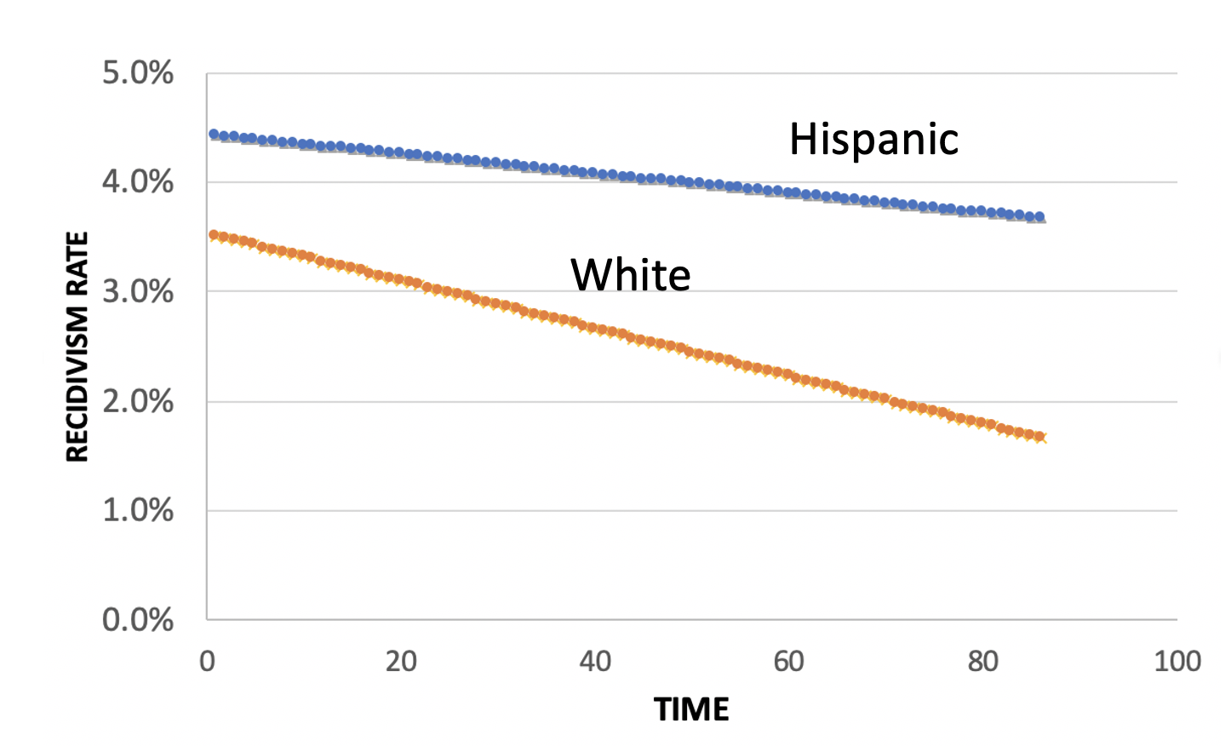
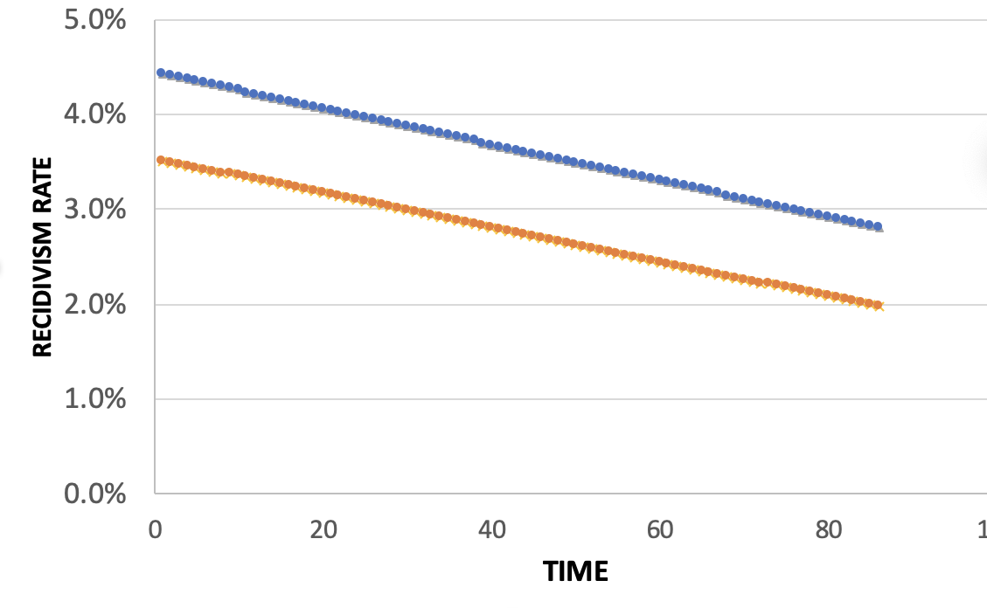
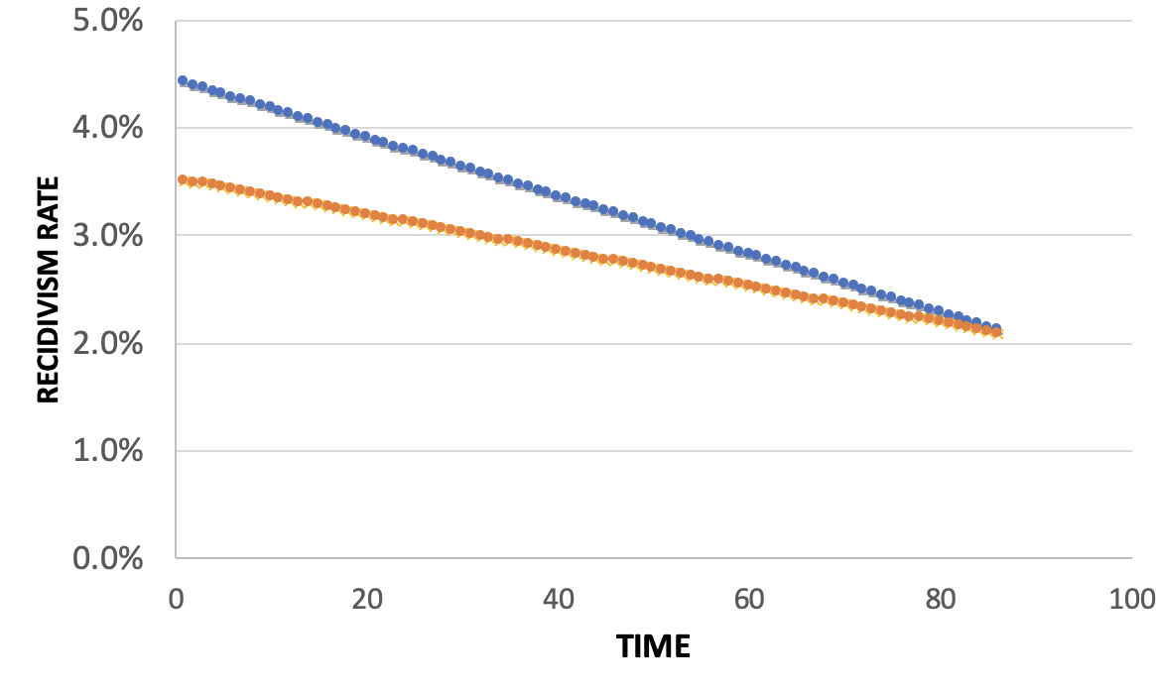
Policy Menu
Designing for Efficiency
72.7% Efficient
Equality
Additional Cost: 2%
Equity
Additional Cost: 2%

Slide 39
We may not have to sacrifice accuracy in order to get fairness but we do have to deliberately and explicitly design our AI/ML systems for equity and fairness

Slide 40
Some common practitioner perceptions
There is always a tradeoff between fairness and accuracy
I have to satisfy all measures of bias in order to be fair
I have to eliminate all bias in order to use/deploy an ML system
Not using race in my models makes by models not racist
Using race in my models makes my models racist
A fair ML model = Fair and equitable outcomes
Bias comes from and can be fixed by “fixing” the data
Bias reduction methods actually reduce bias

Slide 41
How to get ready?
Create an environment where informed “values” discussions can take place
Talk through value choices at each stage of the project (instead of waiting till the end): data collection to analysis to action to impact
Consider how it affects people throughout the chain – especially the people being affected (and include them in these discussions and decisions)
Match the design to deployment scenarios
Measure outcomes – but the right outcomes
Test, Test, Test – but the right tests
Monitor and Update

Slide 42
Summary
Data Science, Machine Learning, and AI are giving us ways to design more “personalized” policies that are more efficient, and have the potential to be more equitable
Our focus should not just be on designing technical systems that are fair but on on supporting decisions that lead to equitable outcomes
Need to create environments, trainings, methods, and tools to support the values to outcomes chain

Slide 43
Useful Resources
Data Science Project Scoping Guide
Open Source Data Science Tools
Triage: ML Toolkit
Aequitas: Bias Audit Tool
Code for all projects: www.github.com/dssg
Hands-on Fairness and Bias Tutorial
Data Science for Social Good Fellowship

Slide 44
Rayid Ghani
rayid@cmu.edu

